Slide 1

Eco-Resilient Networks Smart Deployment for the Future
Muhammad Hamza Shahab
Syed Haider Abbas Naqvi
9th February 2025
Researching and Engineering Community Centred Software
Notes:
Brief intro - "Good morning, we're presenting our progress on the Eco-Resilient Networks project."

Slide 2
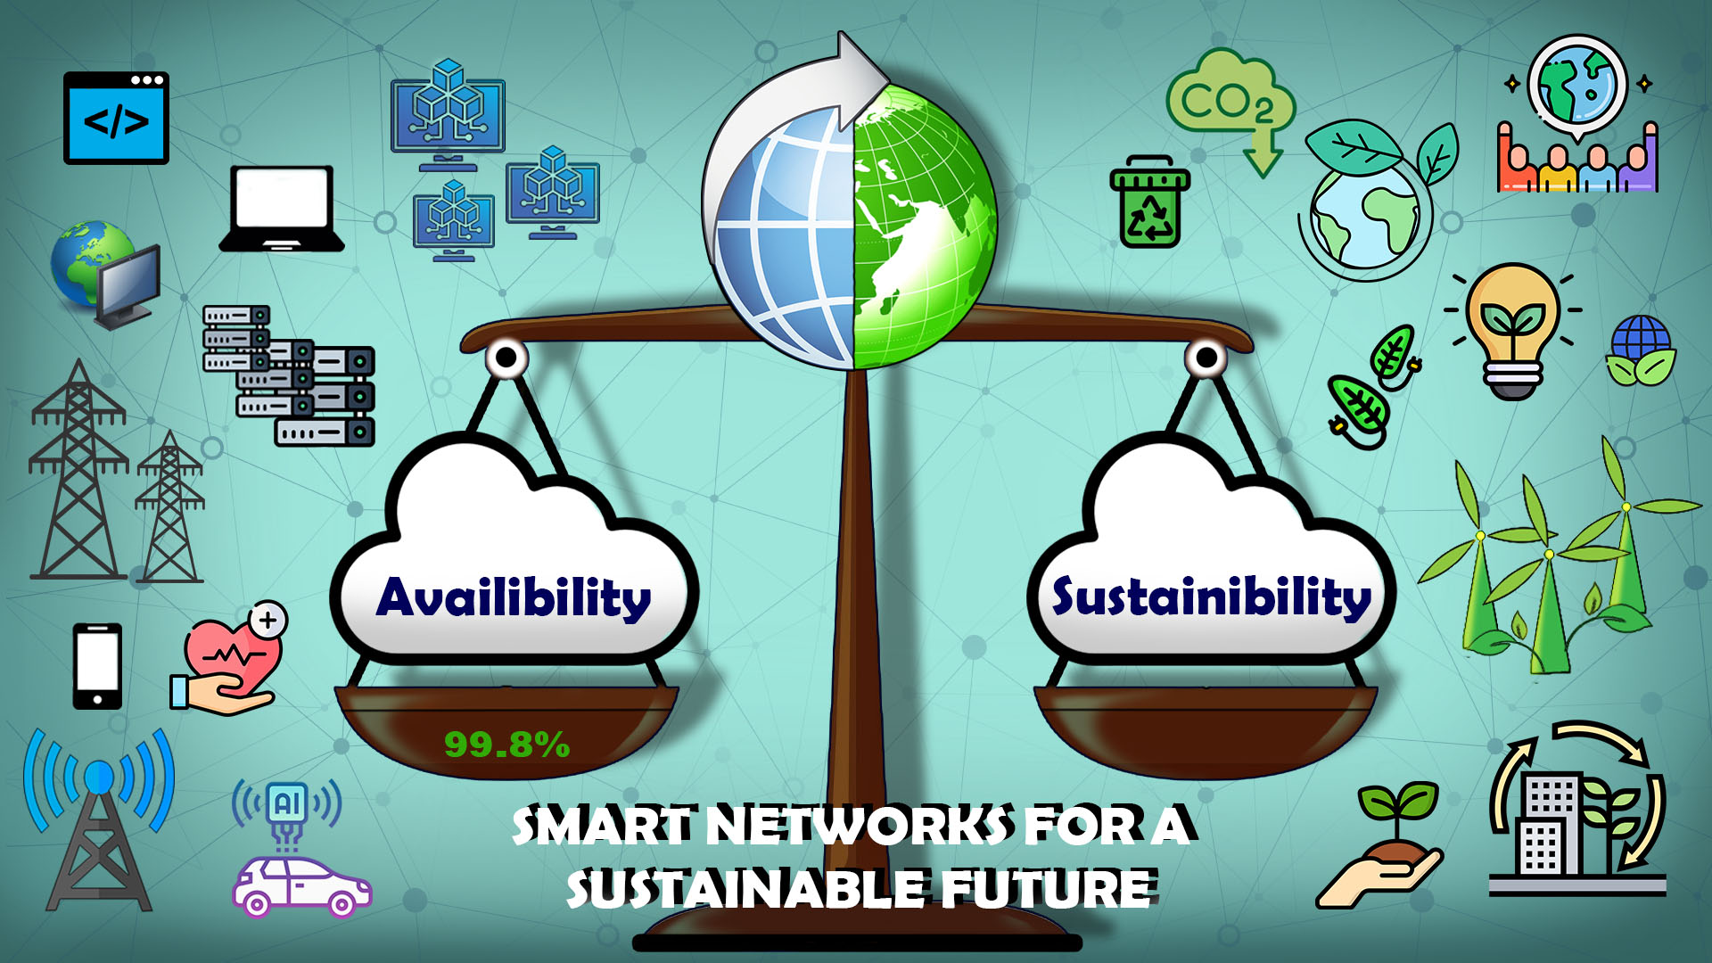






Project Goal and Target Community
Goal:
Develop a system to optimize network deployment
Considering BOTH high availability AND sustainability in edge-cloud environments.
Community:
SaskTel network engineers and architects (primary).
UN SDGs:
SDG 7: Affordable & clean energy
SDG 11: Sustainable cities & communities
SDG 12: Responsible consumption & production
SDG 13: Climate action
Notes:
Our project addresses the need for both reliable and sustainable networks. We're focusing on SaskTel as our primary user community.

Slide 3




The Challenge: Existing Network Management
Current tools prioritize network uptime (availability)
Solarwinds
Nagios
Limited consideration for energy consumption and carbon footprint.
Reactive approach (responding to issues) rather than proactive optimization.
Need for joint optimization of availability and sustainability.
Notes:
Current solutions often overlook the environmental impact. We need a new approach.

Slide 4
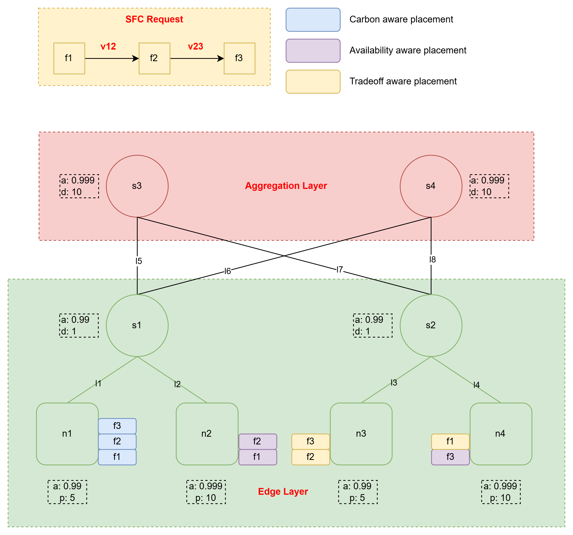
Our Approach: Joint Optimization for Eco-Resilience
Service Function Chains (SFCs)
A series of virtual network functions (VNFs)
VNFs: Software-based network services, (firewalls, load balancers), that run on virtualized infrastructure instead of dedicated hardware.
Edge-Cloud Continuum
Computing paradigm that integrates edge and cloud resources to process data efficiently.
Embedding Policies
Availability-Aware: Focuses on maximizing availability of the system
Carbon-Aware: Focuses on reducing carbon footprint of the system.
Tradeoff-Aware: Focuses on achieving balance
Optimization Algorithms
Particle Swarm Optimization (PSO)
Simulated Annealing (SA)
Genetic Algorithm (GA)

Slide 5
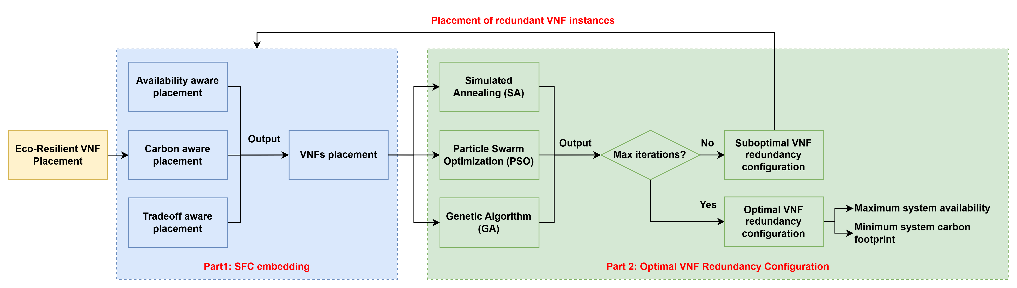
Our Approach: Joint Optimization for Eco-Resilience

Slide 6
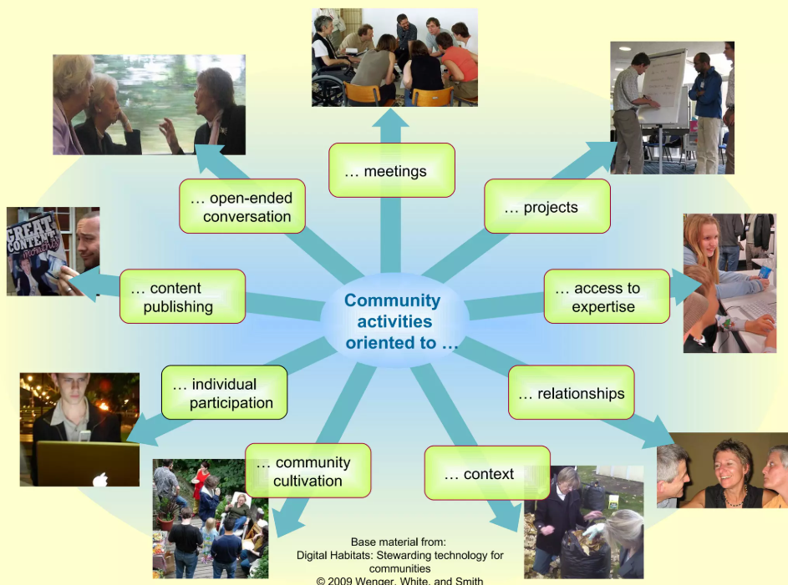
Community Orientation & Needs
Community Life Cycle:
Stable and adapting.
Dominant Orientations:
Projects,
Content,
Access to Expertise,
Service Context.
Key Needs:
Integration with existing systems.
Minimal disruption to operations.
Demonstrable benefits (availability, sustainability, efficiency).
Notes:
We analyzed the SaskTel community's needs and technology landscape to ensure our project is relevant and impactful.

Slide 7
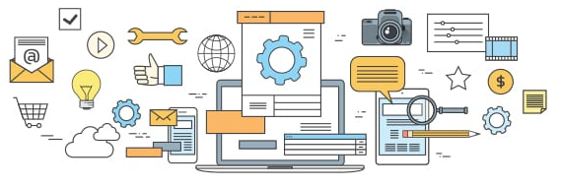
Technology Inventory: Current Landscape
Platforms:
Network Management System (NMS)
Software Defined Network (SDN) Controller
Cloud Platform (Public/Private)
Network Function Virtualization (NFV) Orchestrator
Tools:
Network Monitoring Tools
Documentation Tools
Data Visualization Tools
Notes:
This is a simplified overview of the existing technology environment. Our project aims to integrate with this landscape.

Slide 8


Identifying Gaps and Opportunities
Gaps:
Lack of integration between operational tools and sustainability metrics.
Limited built-in capabilities for advanced optimization (joint availability/sustainability).
Opportunity:
Our project provides a solution for proactive, joint optimization.
Notes:
We identified key gaps in the current technology: a lack of focus on sustainability and limited optimization capabilities.

Slide 9

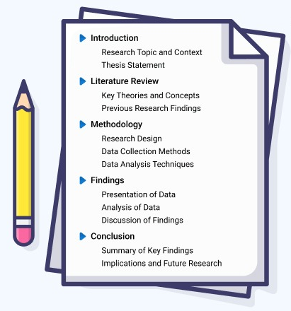


Project Scope and Deliverables
Scope:
Simulation-based,
Focused on video streaming over 5G.
Deliverables:
Simulation framework (open-source).
Embedding policies and optimization algorithms.
Performance analysis and recommendations.
Research paper.
Exclusions:
Real-world deployment,
GUI,
dynamic conditions (initially).
Notes:
We've defined a clear scope, focusing on simulation and analysis. We'll deliver a working simulation, algorithms, and a research paper

Slide 10
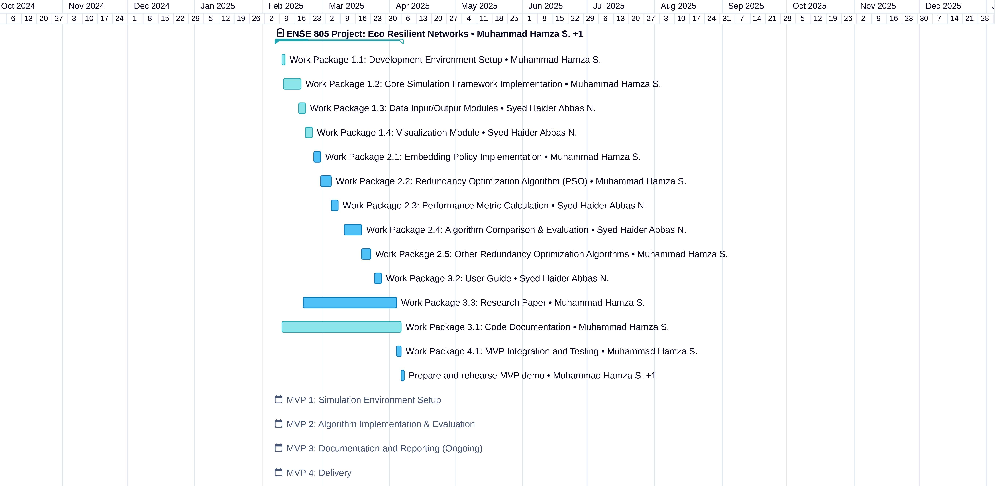
Activity-Based Schedule & MVPs
Notes:
This is a simplified overview of the existing technology environment. Our project aims to integrate with this landscape.

Slide 11
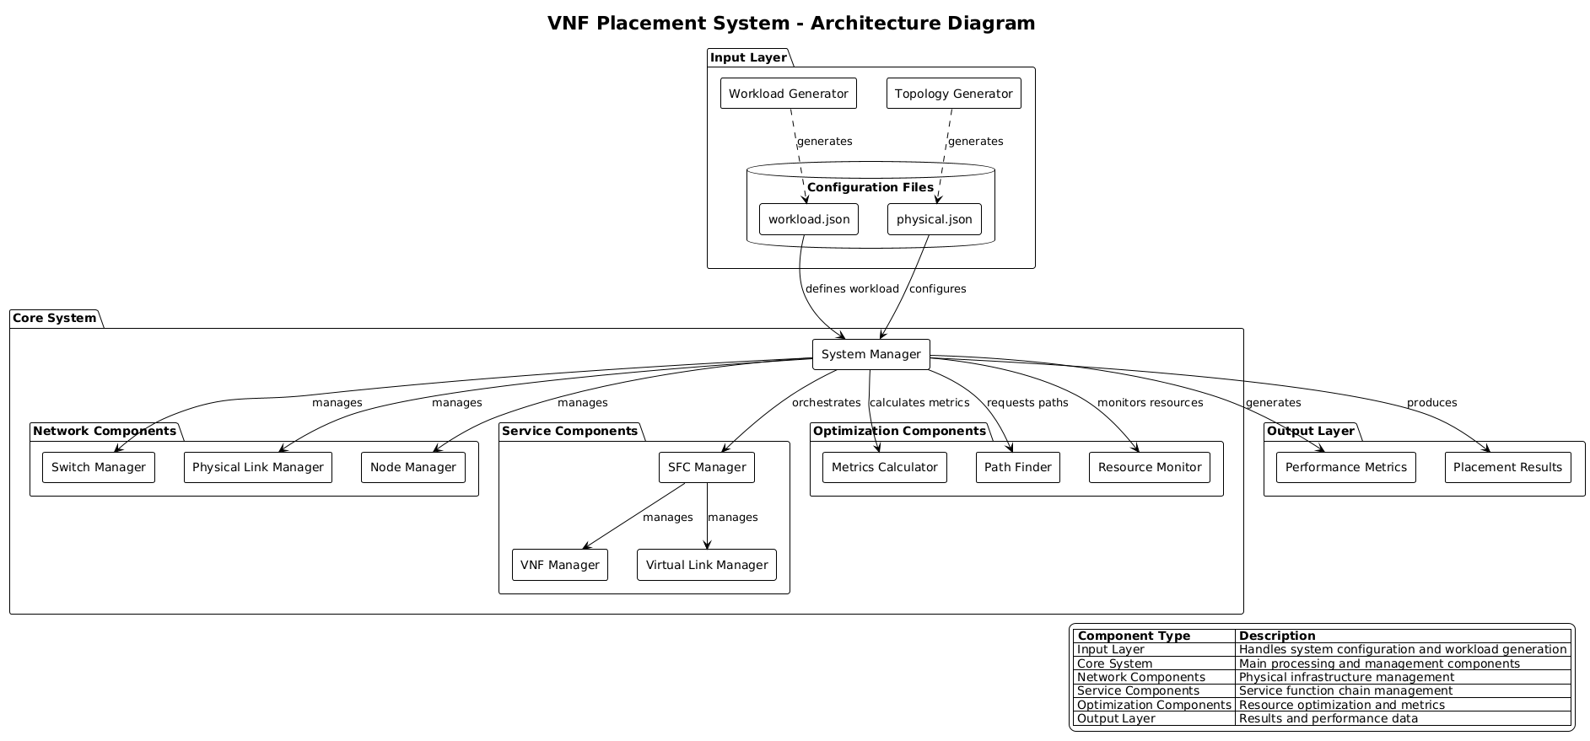
System Architecture (High-Level)
Notes:
This shows the main components of our system and how they interact.

Slide 12
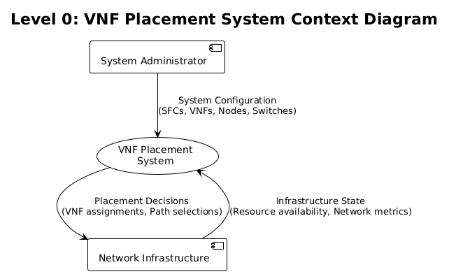
Data Flow Context
Notes:
This shows how the system handles data.

Slide 13

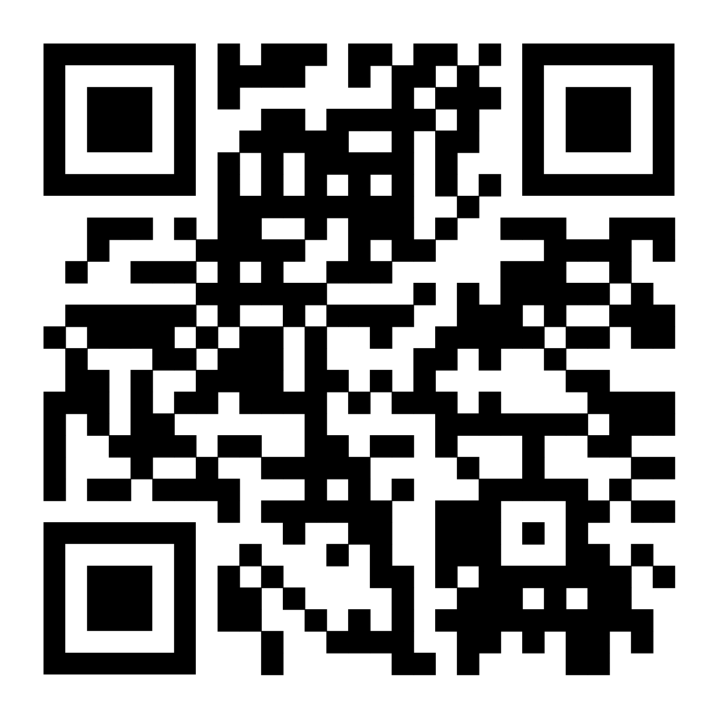
Thank You - Let’s Build Sustainable Networks!
Project Link: https://github.com/hamzashahab1610/ENSE-805-Project-Eco-Resilient-Networks.git
Contact:
Email: msx044@uregina.ca
LinkedIn: https://www.linkedin.com/in/hamzashahab1610/
GitHub: https://github.com/hamzashahab1610

